Slide 1
Nneoma onwe

Slide 2
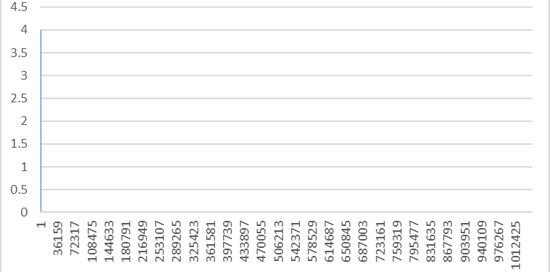
This is the activity level on the on the chart

Slide 3
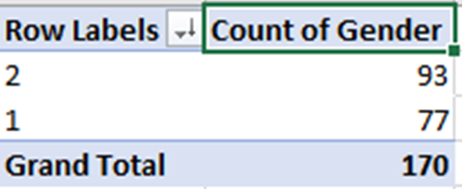
Pivot table
In this pivot table will show the gender and the number of time 2 in was enter 93 time and 1 was enter 77time which make at total of 170

Slide 4
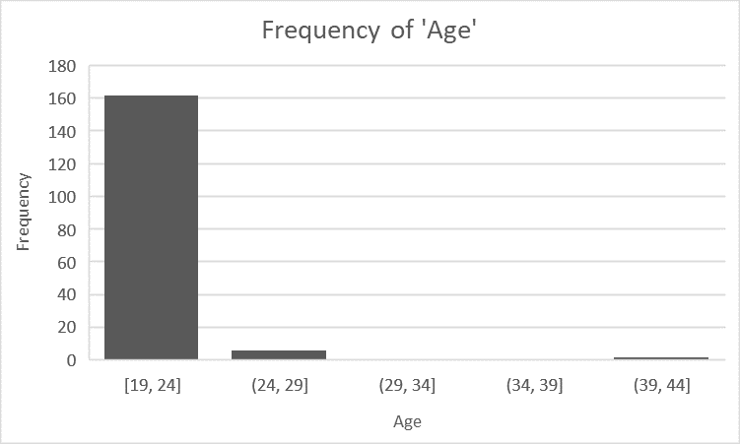
Frequency table of age
In this data it show the age frequency from 19,24 and 24,29 and 29,34,and,34,39,and,39,44

Slide 5
If count

Slide 6
Pie chart

Slide 7
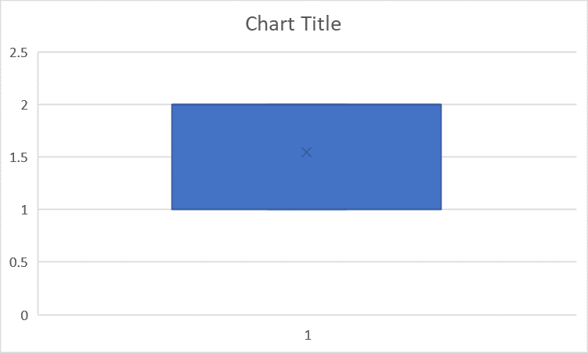
Box plot

Slide 8
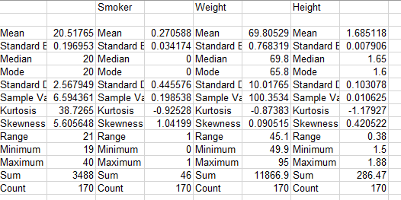
Statics des
This is STATS Table of smoker, weight ,height which give mean,medium,mode, range, sum,count and other more

